Slide 1
Rikki-Tikki-Tavi
By
Rudyard Kipling

Slide 2
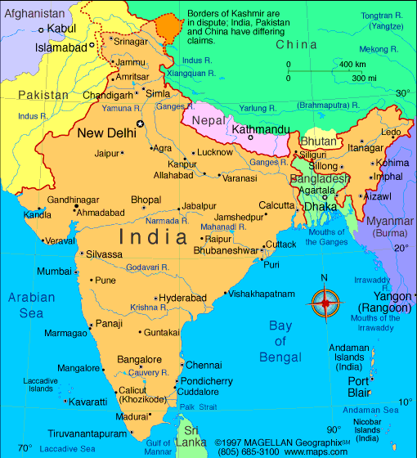
This story is set in India during the late 1800s.

Slide 3
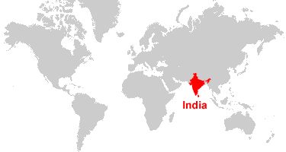
At that time, Great Britain ruled India.

Slide 4
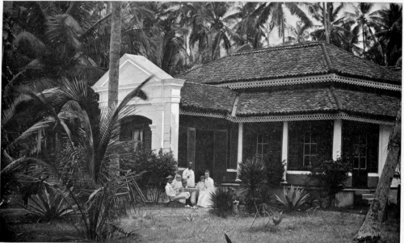
British families lived in open, airy houses called bungalows.

Slide 5
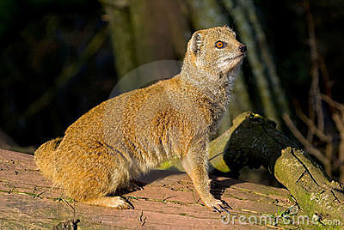
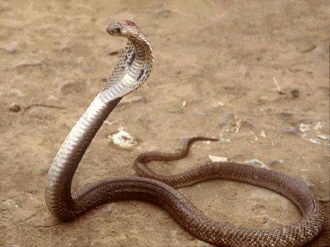
If you lived in India, you certainly would know the mongoose and the cobra as a pair of natural enemies--

Slide 6
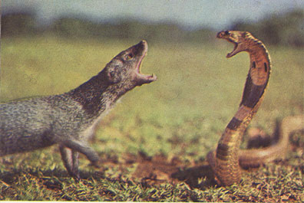
A pair that will fight to the death.

Slide 7
Personification
When a writer gives human qualities to an animal, object, or idea, the technique is called personification.
The author, Rudyard Kipling, uses personification in “Rikki-tikki-tavi”.
Personification allows readers to imagine what the animals think, feel, and say about each other.

