Slide 1
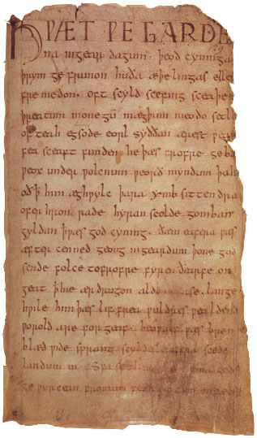
Beowulf The first great work of English national literature

Slide 2
Why study literature as historical record?
1. Literature becomes a cultural record
2. Interprets the social climate of an age
Records the feelings of people of a time
Note: It is a limited view because only higher class could read & write

Slide 3
Brief history of the British Isles
700 – 300 BC
Earliest known inhabitants
were the Iberians.
300 BC
Greek travelers found a group of people called the Celts. Among the Celts was a tribe called the Brythons – Britons – from which comes the eventual name of the country, Britain.

Slide 4
Roman and German influence
55 BC Julius Caesar invaded the British Isles.
-Celts defeated
-Built roads, towns
-Brought Christianity (which later unified country)
-Romans left to defend their empire
What would have happened if Romans had remained on the British Isles?
400 BC German tribes invaded the Isles – the Saxons, Angles & Jutes
-Drove out old Britons
-Mixed languages
-Land took new name
Engla land – from Angles
-England was divided into independent “kingdoms”
-King known as Alfred the Great unified country against invading Danes.
-Christianity helped unify

Slide 5
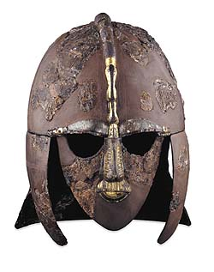
Anglo-Saxon Society
Anglo-Saxons often depicted as barbarians. They were a warrior culture, but also valued:
-Importance of family/identity
-Loyalty to feudal lord
-FAME…must be remembered for good deeds to gain immortality
Exile was greatest punishment
Cowardice was the greatest sin.
“

Slide 6
Anglo-Saxon Religion
*Warrior gods honored
*Dark, fatalistic religion brought from Germany.
*Derived from Norse and Scandinavian myths.
*Odin, the god of death
*Thor, god of thunder and lightning. Symbols of hammer & twisted cross.
*Dragon symbols
“Anglo-Saxons had more concern with ethics than mysticism – with earthly virtues of bravery, loyalty, generosity and friendship.” (Elements of Literature, 6th course)

Slide 7
Beowulf
Written approximately 1100 AD
Unknown author (probably a monk)
The earliest form of literature written in English.
Only 20,000 lines of Old English still exists
Combines Anglo-Saxon & Christian religion

Slide 8
The Creation of Beowulf
*Communal halls – mead halls – provided place for skilled storytellers.
They were called bards or scops .
*Scops were respected the same as warriors. Creating poetry was as important as any other task.
*Strumming harps the scops told heroic tales.
2 kinds of EPICS
1. folk epic – story come from a tradition of a culture
example – Homer’s Illiad & the King Authur legends
2. literary epic – story derived from one person

Slide 9
Beowulf embodies Anglo-Saxon Values
Beowulf is an epic poem. It is a long, narrative poem relating the great deeds of a larger than life hero who embodies the values of the Anglo-Saxons.
Those values are:
Bravery
Loyalty to family and protecting lord
Honesty (even to boast)
To bring honor to family and lord

Slide 10
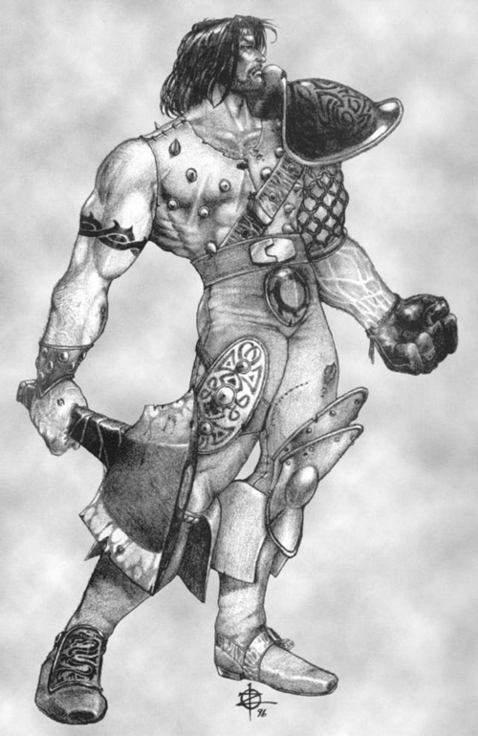
The written Beowulf
Beowulf was probably written down by a Christian monk. The written version was infused with Christian and pagan elements around 700 AD.
What’s really unusual is it was written in ENGLISH, not Latin which was the serious language of the day. English was the vernacular, the language of the common people. However, for us today, it must read in translation.

Slide 11
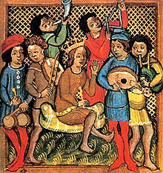
Things to look for while reading:
Alliteration is the repletion of the same consonant at the beginning of words Example: Great green giants gone for good/ Forsworn forgotten folk forever followed and fair.
Cadence is the music the language creates in its rhythm and build.

